Slide 2
Loan Application
January 30, 2024

Slide 3
Agenda
Objective
Problem Statement
Implementation
Input & Output

Slide 4
The primary aim of this project is to create a console-based application for Loan Application . It enables users to Submit the details for Loan approval. Here I am taking input as First name, Last name, Father Name and Company Name etc. After successful submission of user details, we can get all the details which were entered by user for preview.
Objective

Slide 5
Problem Statement
Design a simple console-based Java program for a Loan Application. The program should allow users to enter the details for Loan approval. We have to get information like First Name, Last Name, Father Name, Company Name and ID number etc. This level aims to provide a foundational understanding of Java programming and basic user interactions.

Slide 6
Implementation
Class & Object
Exception Handling
Encapsulation
Packages
Scanner class

Slide 7
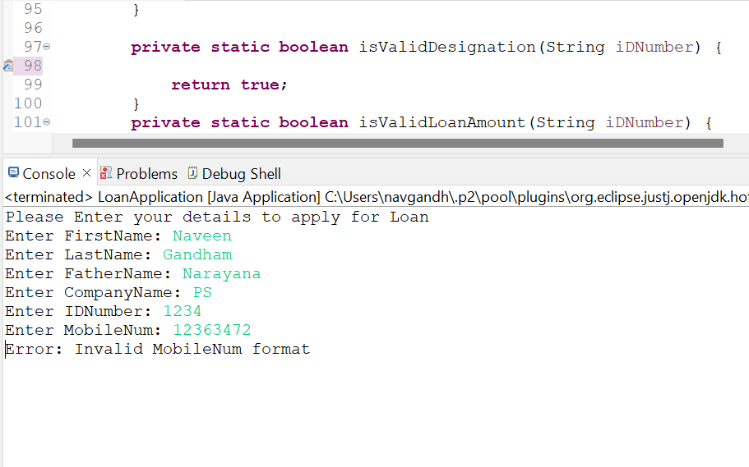
Exception Handling
Exception Handling in Java is one of the effective means to handle runtime errors so that the regular flow of the application can be preserved. Java Exception Handling is a mechanism to handle runtime errors .

Slide 8
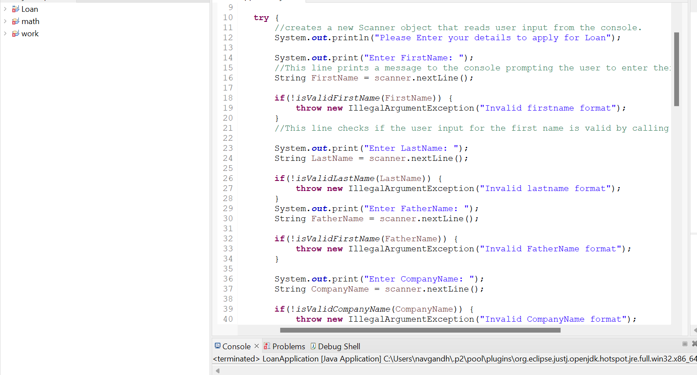
Logic

Slide 9
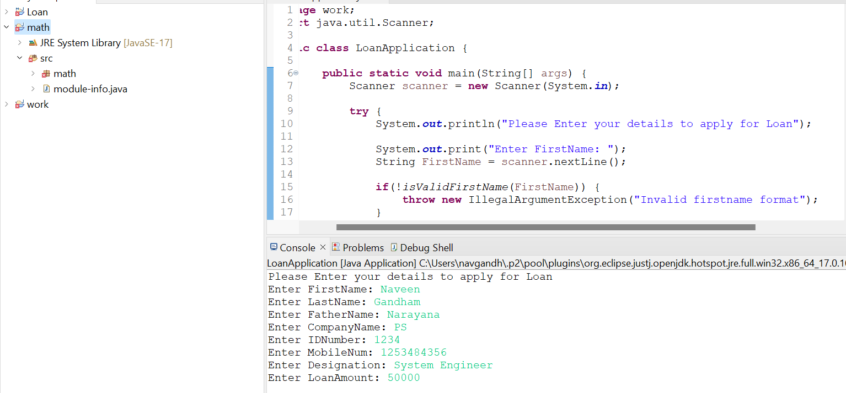
Input

Slide 10
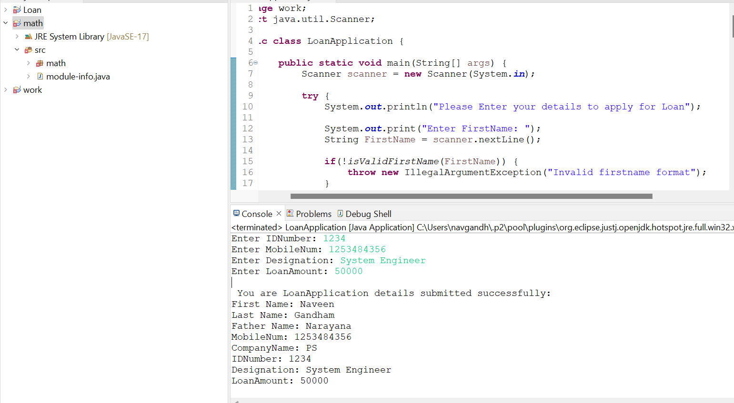
Output

